Slide 1
FirstMile Process
Filing a claim through FirstMile Portal

Slide 2
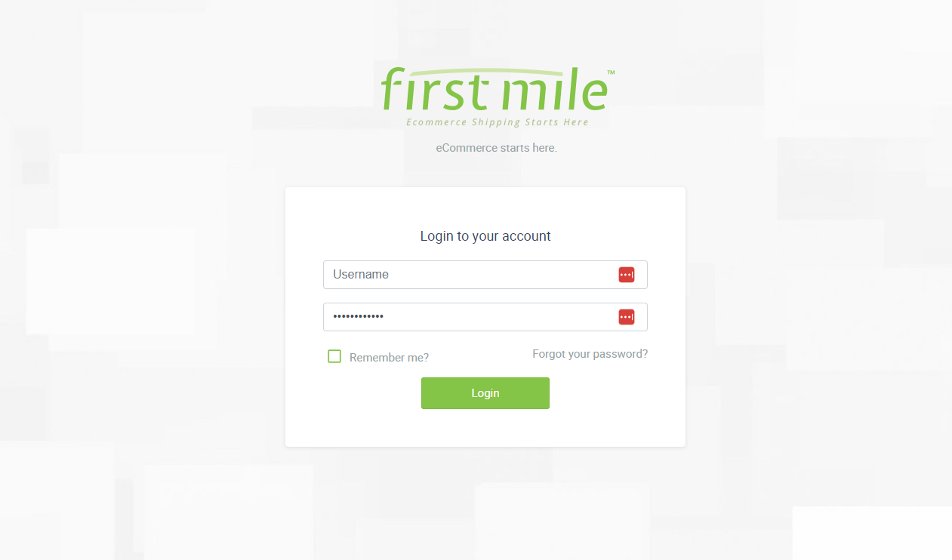

Login to your FirstMile Portal account https://portal.firstmile.com/

Slide 3
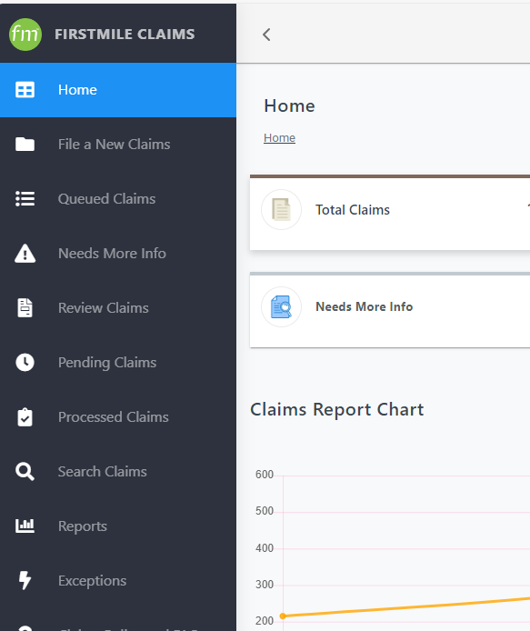
Claims Portal
Select the Claims Tool after your login screen
This will take you to the claims dashboard

Slide 4
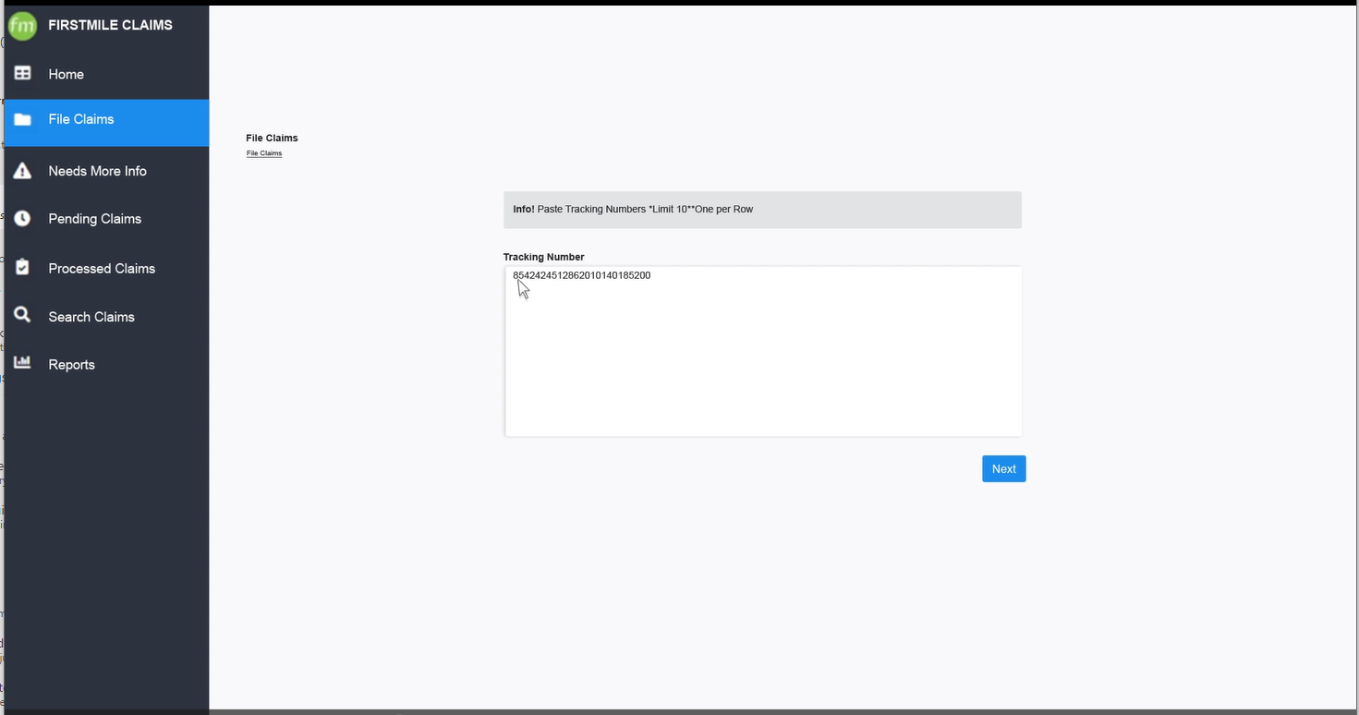
File new claim
Select “file claims” along the tabs on the left side
You can enter up to 10 shipments at one time.
Then select “Next”

Slide 5
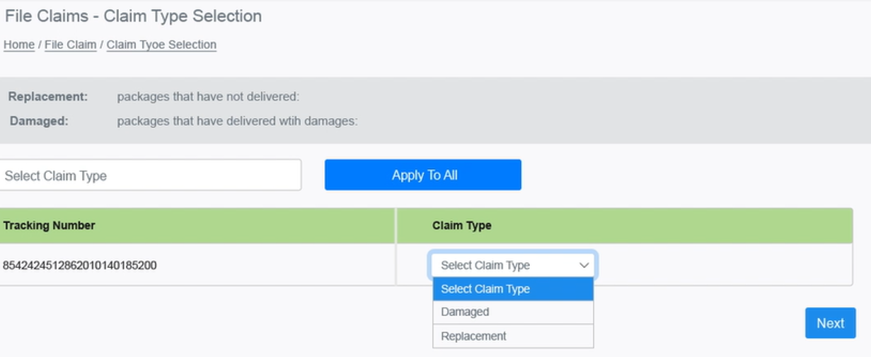
Select Claim Type
The next page will ask you for the claim type.
You can choose between, Replacement or Damaged

Slide 6
Queued Claims
All claims will go into the Queued Claims for a preprocessing period for around 24 hours. Some claims may take longer to further determine the eligibility of the claim.
Once the preprocessing is complete the claim will move into Needs More Info

Slide 7
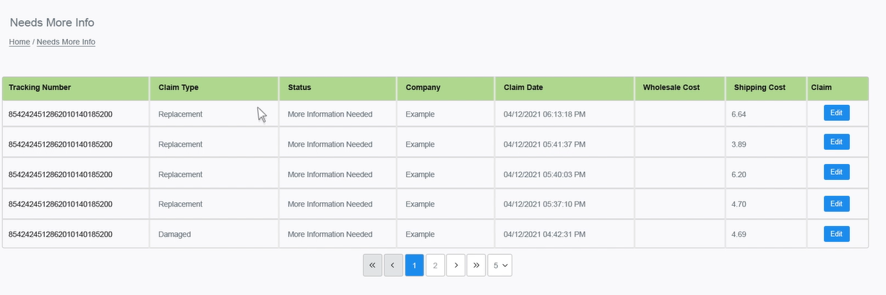
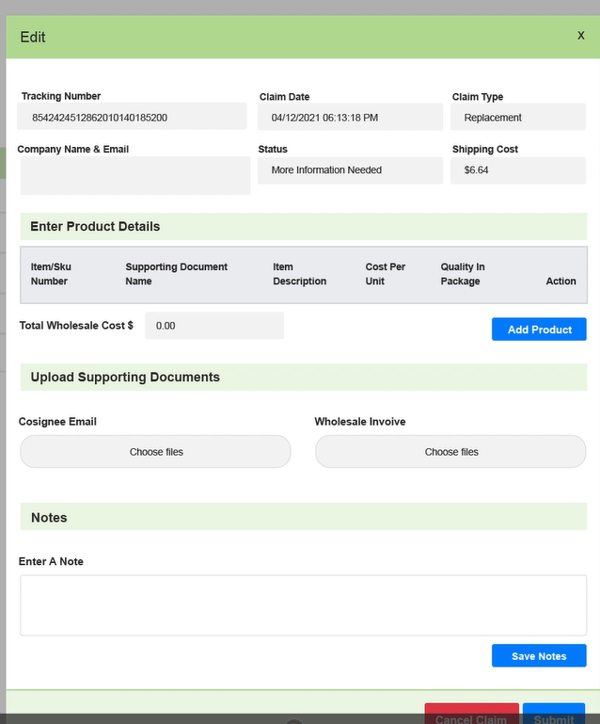
Needs More Info
The next step in the process is entering the information for your claim
Select the claim that you would like to edit
Add company name and email
Select “Add Product” to update product in the shipment

Slide 8
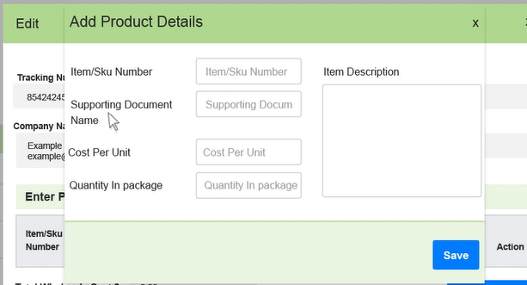
Add Product Details
Enter in the product details including: Item or Sku Cost of item(s) Quantity of item(s).
Upload supporting information (invoices and wholesale costs) then “Save”

Slide 9
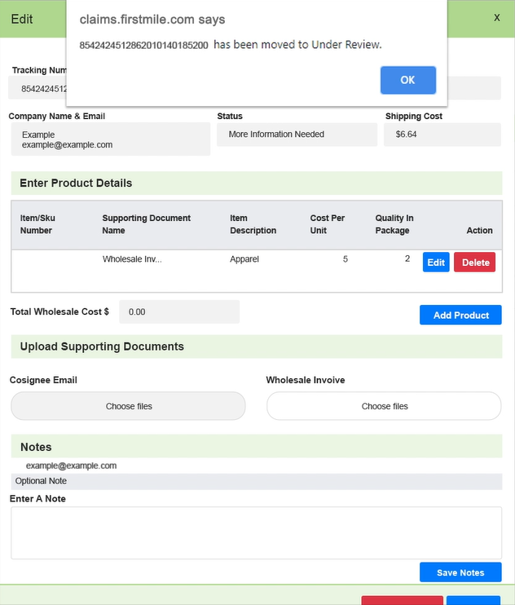
Confirmation Page
After adding all required information, select “submit”.
You will then receive a confirmation that it was successful.
If it was not successful, an error message will indicate a reason and you can proceed from there.

Slide 10
Claims FAQ
Time Requirements
Domestic Packages: Eligible 7 days with no updated physical scans, submit on the 8th day; No later than 75 days after shipment date
Documentation
Email from consignee stating they have not received item.
Your wholesale invoice or breakdown of cost.
Max Payout
Packages Under 1 LB - $50
International Packages: Eligible 45 days from first physical scan; No later than 75 days after
If damaged, picture of items damaged including packaging.
Packages Over 1 LB - $100
Additional service coverage is available on all shipments prior to them being picked up by the carrier

Slide 11
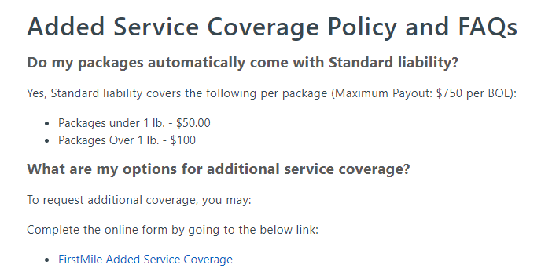
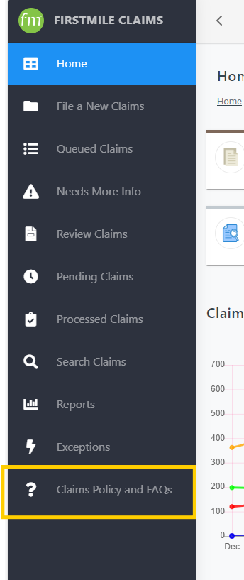
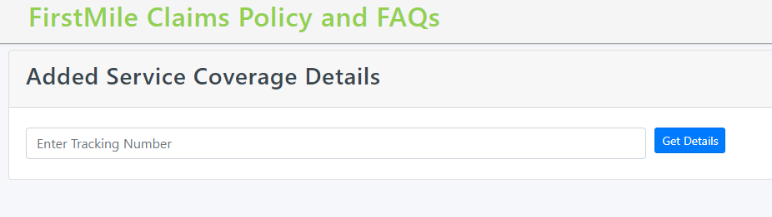
Added Insurance

Slide 12

Thank you
We appreciate your partnership!
| Julie Abbott|
claims@firstmile.com

